Slide 1
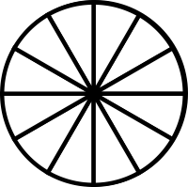
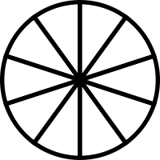
At a party there are 2 cakes. The chocolate mud cake is cut into 12 pieces and the cheesecake is cut into 10 pieces. You have 2 pieces of chocolate cake and 3 pieces of the cheesecake. What fraction of cake have you had over all?

Slide 2
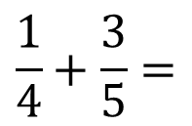

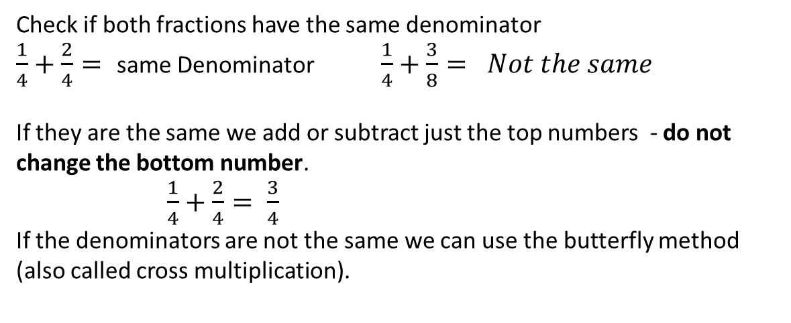
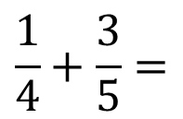
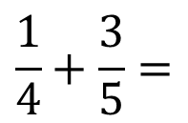
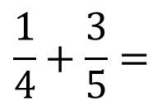
Topic :
24
7
30
Date
EQ : How do we add fractions?
Check if both fractions have the same denominator
$\frac{1}{4}+\frac{2}{4}=$ same Denominator $\frac{1}{4}+\frac{3}{8}= Not the same$
If they are the same we add or subtract just the top numbers - do not change the bottom number.
$\frac{1}{4}+\frac{2}{4}= \frac{3}{4}$
If the denominators are not the same we can use the butterfly method (also called cross multiplication).
5
12
5
12
5
$$\frac{1}{4}+\frac{3}{5}=$$
$$\frac{1}{4}+\frac{3}{5}=$$
$$\frac{1}{4}+\frac{3}{5}=$$
$$\frac{1}{4}+\frac{3}{5}=$$
$$\frac{5+12}{20}=\frac{17}{20}$$
20
1 x 5 = 5
4 x 3 = 12
4 x 5 = 20

Slide 3
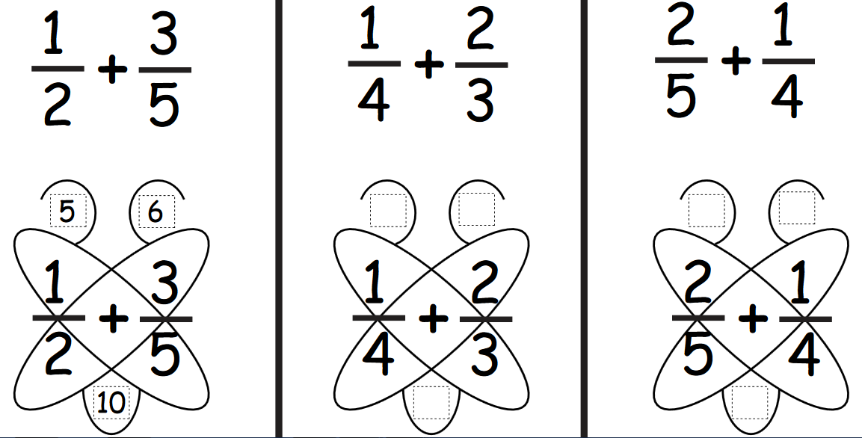
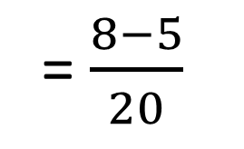
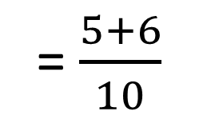
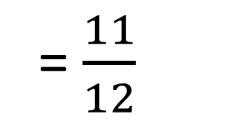
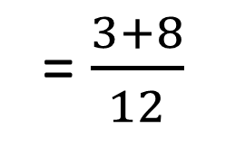
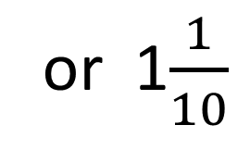
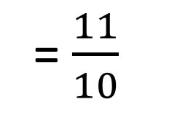
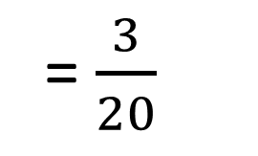
-
3
8
8
5
-
12
20
= $\frac{5+6}{10}$
= $\frac{3+8}{12}$
= $\frac{8−5}{20}$
= $\frac{11}{10}$
or 1$\frac{1}{10}$
= $\frac{11}{12}$
= $\frac{3}{20}$

Slide 4

Your turn to try a couple.
$\frac{1}{7}+\frac{2}{7}=$ $\frac{3}{5}−\frac{2}{5}=$
$\frac{3}{10}+\frac{2}{3}=$ $\frac{3}{4}−\frac{1}{6}=$

Slide 5
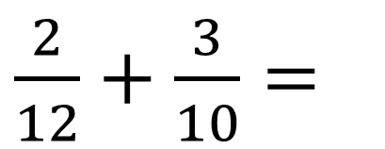
At a party there are 2 cakes. The chocolate mud cake is cut into 12 pieces and the cheesecake is cut into 10 pieces. You have 2 pieces of chocolate cake and 3 pieces of the cheesecake. What fraction of cake have you had over all?
$\frac{2}{12}+\frac{3}{10}=$

Slide 6
Task.
Complete the worksheet and paste it into your workbook.

Slide 7
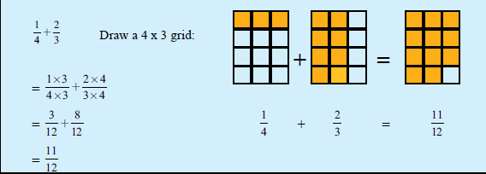
Topic : Adding Fractions
24
7
30
Date
EQ : How do we add fractions?
Notes:
Alternative method for those that want it.

